Slide 1
Qualitative Research IV: Laddering

Slide 2
Overview
The Laddering Concept
Means-Ends Chains
Laddering Technique
Laddering Examples

Slide 3
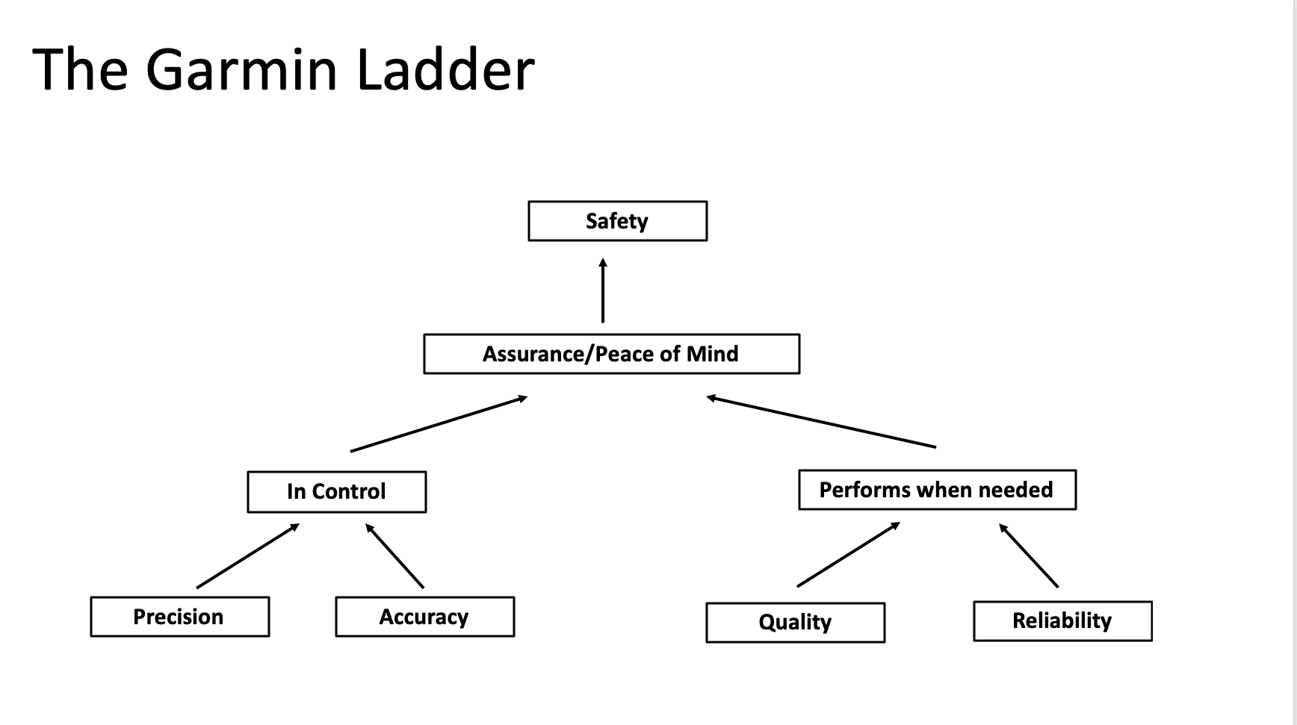
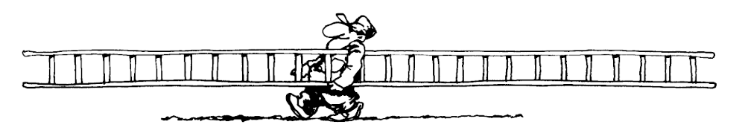
Laddering Example

Slide 4
Laddering Technique - Means-End Structures
Assumptions:
Consumers buy products primarily to do something, i.e., solve important consumption problems
Product knowledge is organized in terms of what products do -- their consequences.
Consequences vary in abstraction
Attributes, consequences, and values are linked to form an associative network of brand perceptions -- a means-end chain.

Slide 5
Laddering Technique - Means-End Structures (2)
Concrete Attributes
Product Knowledge
Abstract Attributes
Functional Consequences
Psychosocial Consequences
Self-Knowledge
Instrumental Values
Terminal Values

Slide 6
Laddering Technique - Means-end Structures (3)
Concrete attributes
  Cognitive representation of physical characteristics
  Can be perceived directly
    Example: price
Abstract attributes
  Abstract representation or “chunk” standing for several more concrete attributes
  Not directly measurable
    Example: good quality

Slide 7
Laddering Technique - Means-end Structures (4)
Functional consequences
  Whether the product does what it is supposed to do
  Whether it functions appropriately
    Example: Handles easily
Psychosocial consequences
  How product makes person feel
  How that person perceives that others feel about them as a result of using the brand
    Example: Others see me as special

Slide 8
Laddering Technique - Means-End Structures (5)
Instrumental values
  Preferred modes of conduct
  Abstract consequences of using it
    Example: Being center of attention
Terminal values
  Preferred end states
  Very abstract consequences
    Example: Security

Slide 9
Laddering Questioning Technique
Keep asking “Why?”
Find a hierarchical structure of attributes, consequences and values that consumers have about the brand.

Slide 10
Example: Bud Light Ladder 1
Why do you drink Bud Light?
  Because it is healthier and less filling. (functional consequences)
  Why is it important for you to be healthy?
  Because I can accomplish a lot after drinking a Bud Light.
  I can even accomplish more! (functional consequence)
  Why is it important for you to accomplish more?
  Because I feel better about myself when I accomplish a lot. (psychosocial consequence)

Slide 11
Example: Bud Light Ladder 2
Why do you drink Bud Light?
  I drink it because I watch the calories. (physical attribute)
Why is it important for you to watch the calories?
  Because I want to avoid gaining weight! (functional consequence)
Why do you want to avoid gaining weight?
  I want to stay skinny. That’s the personal image I have about myself. It is also what other people expect me to be. (psychosocial consequence)

Slide 12
Example: Bud Light Ladder 2 (Continued)
Why do you want to meet people’s expectations?
  I feel they will only accept me when I am like this. (instrumental value)
Why is it important for you that people accept you?
  Because I feel much better about myself when I know that other people think I look good. (terminal value)

Slide 13
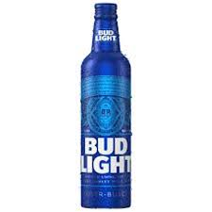
The Bud Light Ladder
Self-esteem
Accomplishment
Social Acceptance
Personal Image
Healthier
Control Weight
Less Filling
Fewer Calories

Slide 14
Conclusion
Laddering is an excellent technique for digging deeper into consumers’ brand preferences.
Exercise: find a partner and try laddering his/her favorite brand. (Be sure to warn them that you will be asking “Why?” a lot!)

Slide 15
End of Lecture

